Slide 1
SQL Injection
CST8276 – Group 22
November 25th, 2022
Notes:
SQL Injection is all about stealing access to data. A good analogy is robbing a bank.
It’s like putting on a janitor’s uniform, walking right through the front door and past the security guard into the vault (database).

Slide 2

SQL Injection
Unauthorized modifications caused by user-supplied data
Malicious data retrieval
Financially damaging
Ever present problem in public-facing databases
Notes:
SQL Injection essentially is when a person/user, usually from the public, tries to hide SQL commands in the text that they enter into application’s text input fields.
This occurs usually during registration or login process, into order to get the server to run those hidden SQL statements, and give the attacker greater access to the database, or just damage it, usually by dropping tables.

Slide 3


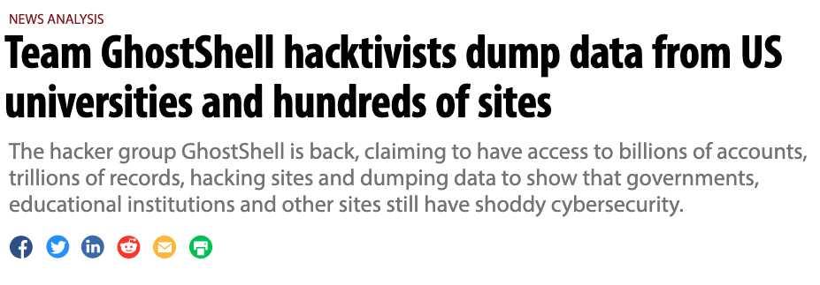
SQL Attack Examples
Notes:
In the past decade, thousands of corporations, universities and governments, have publicly been victims of SQL injection attacks.
In 2011 A hacker group was able to use SQL Injection to gain access to the PBS news servers. The group posted stolen passwords, alongside a story headlined “Tupac still alive in New Zealand.”
In 2015, a large number of universities and government institutions were bled for user accounts and other sensitive user related information by a hacker group called Ghostshell.

Slide 4

The Problem
def unprotected_db_login(username, password):
db_conn = db_Connection()
cursor = db_conn.cursor()
sql = "SELECT * FROM useraccount WHERE username = '" + \
username + "' AND password = '" + password + "';"
cursor.execute(sql)
return cursor.fetchall()
tom' or '1'='1,
Notes:
SQL injection vulnerabilities occur from the way that SQL queries are implemented in your code.
Here we see how you could write a query, it works, but it introduces opportunities for hackers.
This coding style can cause the confusion between code and data if certain text is inputted by the user.

Slide 5


Our Solutions
Security in Application Layer
Prepared Statements
Security in Data Layer
Stored Procedures
Notes:
For our demonstration we hope to explore how SQL Injection is achieved, and more importantly, how it can be prevented!
We want you guys to come away with a better understanding why something with such potentially disastrous consequences continues to happen.
Our solution offers two different approaches, with security measures against SQL injection in both the application layer, and the data layer.

Slide 6
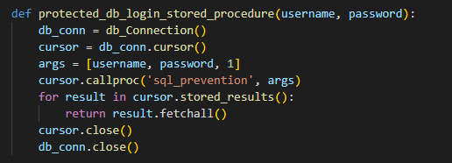
Solution 1 - Passing input to a Stored Procedure for sanitization
Notes:
here we are calling a stored procedure to check the user input for SQL commands.
Certain standard stored procedure programming constructs have the same effect as the use of parameterized queries when implemented safely. However, stored procedures are not always safe from SQL injection.
Note: 'Implemented safely' means the stored procedure does not include any unsafe dynamic SQL generation. Developers do not usually generate dynamic SQL inside stored procedures. However, it can be done, but should be avoided. If it can't be avoided, the stored procedure must use input validation or proper escaping as described in this article to make sure that all user supplied input to the stored procedure can't be used to inject SQL code into the dynamically generated query.
https://cheatsheetseries.owasp.org/cheatsheets/SQL_Injection_Prevention_Cheat_Sheet.html

Slide 7
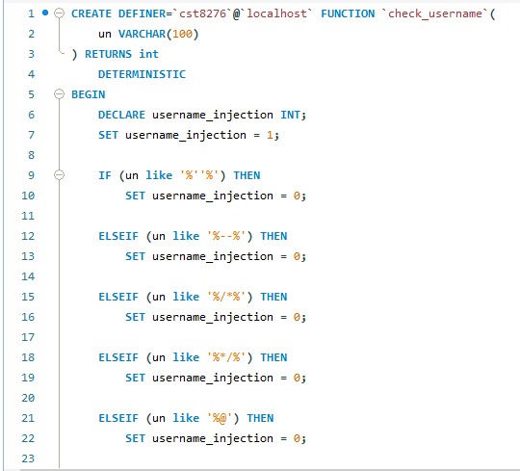
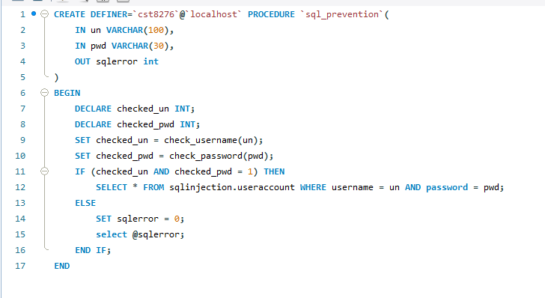
Solution 1 - Stored Procedure with Stored Function Calls
Notes:
Here is a sample of our code where we are using a stored procedure to check the user supplied username for any SQL statements that hackers might be trying to sneak into our database, if there’s a match, the username gets rejected.

Slide 8

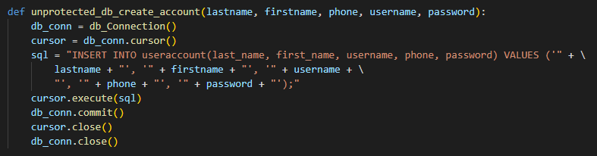
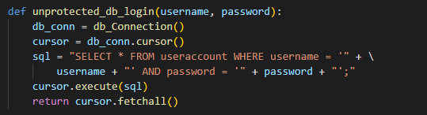
Vulnerable Prepared Statements
Notes:
The issue arises when mixing the code and the data.
If a developer were to create prepared statements where the variables are embed directly into the actual query then this opens up the possibility to alter the query.
The malicious hacker could close the initial query and add an additional query to be executed.

Slide 9
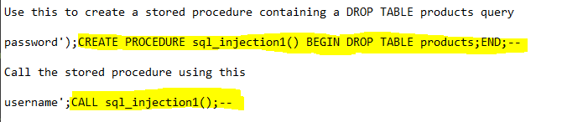
SQL Injection Using Batched Queries
The following SQL injection queries will be used in our demonstration
Notes:
When the malicious hacker creates an account they will enter ‘); after entering their password. This closes the query and allows the user to enter a query to be run afterwards. In our case the user uses a CREATE PROCEDURE query that contains a DROP TABLE query inside. Utilizing the -- in SQL, the user can comment out the rest of the initial query.
Upon submitting, the new user account is created, as well as the STORED PROCEDURE is added to the database. This is where the delayed SQL injection comes into play.
Since the user was successfully able to create a stored procedure, they can now call it at any point in time. For example, the new user could now sign in and call the STORED PROCEDURE at the same time. After entering their username they would close the initial query with ‘; and then call the STORED PROCEDURE using the CALL command. Again, using the -- in SQL, the rest of the initial query is commented out.

Slide 10
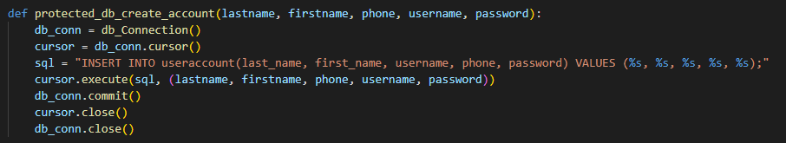
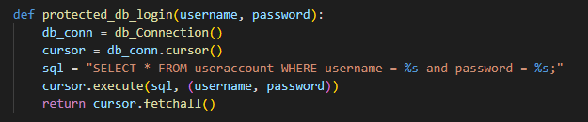
Solution 2 - Parameterized queries
Notes:
The use of prepared statements with variable binding (aka parameterized queries) is how all developers should first be taught how to write database queries.
They are simple to write, and easier to understand than dynamic queries.
This coding style allows the database to distinguish between code and data, regardless of what user input is supplied.
In this example, if an attacker were to enter the userID of tom' or '1'='1, the parameterized query would not be vulnerable and would instead look for a username which literally matched the entire string tom' or '1'='1.
A parameterized query is a query in which placeholders are used for parameters and the parameter values are supplied at execution time. The most important reason to use parameterized queries is to avoid SQL injection attacks.
SOURCE: https://cheatsheetseries.owasp.org/cheatsheets/SQL_Injection_Prevention_Cheat_Sheet.html

Slide 11

Demonstration

Slide 12

Thank you
Notes:
that concludes our presentation! Thank you for attention. Remember, only you, as a developer, can prevent SQL Injection!

